Slide 1

Functions of Random Variables II
Massachusetts Institute of Technology
Fall 2017
Richard C. Larson

Slide 2
REVIEW: 4 Steps to Happiness:
1. Define the Random Variables
2. Identify the joint sample space
3. Determine the probability law over the sample space
4. Carefully work in the sample space to answer any question of interest

Slide 3
4 Steps: Functions of R.V.s
1. Define the Random Variables
2. Identify the joint sample space
3. Determine the probability law over the sample space
4. Carefully work in the sample space to answer any question of interest
4a. Derive the CDF of the R.V. of interest, working
in the original sample space whose probability
law you know
4b Take the derivative to obtain the desired PDF

Slide 4

Carefully work in the sample space to answer
any question of interest.
F_{Y}(y) = P{Y<y}=
P{MIN[X₁, X₂ ]<y}
=1-(1-y)²
f_{Y}(y)=d/dy [F_{Y}(y)]
f_{Y}(y)=2(1-y), 0<y<1
x₂
y
0
y
x₁
4a. Derive the CDF of the R.V. of interest, working
in the original sample space whose probability
law you know
4b Take the derivative to obtain the desired PDF

Slide 5
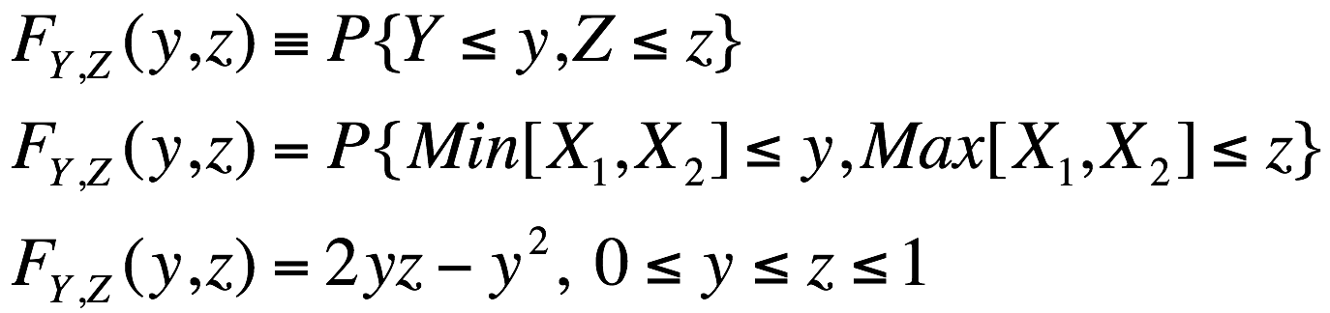
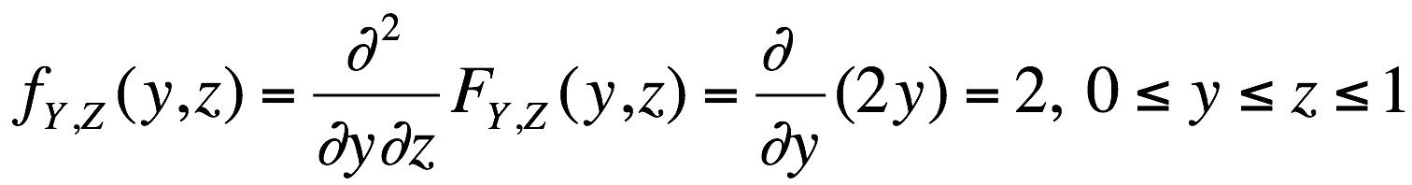
Work within the sample space
x₂
Use CDF
1
z
y
y
z
1
x₁

Slide 6
Work within the sample space
z
Height of pdf = 2
1
What do we do if we do
not have the simple square
symmetry of this problem?
What do we do if the pdf is
not uniform?
0
1
y

Slide 7

Buffon’s Needle Experiment

Slide 8
width of stripe =
d
l < d
l
length of needle =

Slide 9
φ
d/2
φ
y
(l /2)sin(φ)
Want {y <(l /2) sin(φ)}
(Correct error in slides)

Slide 10
1. The R.V.’s
Y = distance from the center of the needle to closest of equidistant parallel lines 0< y < d/2
Φ = angle of needle wrt horizontal 0< φ < π

Slide 11
2. Joint Sample Space
y
d/2
0
φ = π
φ

Slide 12
3. Joint Probability Distribution
Want f_{Y,Φ} (y,φ)
Think about that tricky phrase, “At random”
f_{Φ} (φ) = 1/π 0 < φ < π
f_{Y} (y) = 2/d 0 < y < d/2
Independence implies
f_{Y,Φ} (y,φ) = f_{Φ} (φ) f_{Y} (y)= constant = 2/(π d)

Slide 13
4. Working in the Joint Sample Space
y
Want {y - (l /2) sin(φ)} < 0 or...
d/2
0
φ = π
φ

Slide 14
4. Working in the Joint Sample Space
y
y < (l /2) sin φ
d/2
(l /2) sin φ
0
φ = π
φ

Slide 15
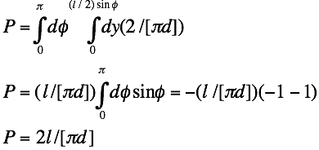
Suppose l = d……. What is March 14?

Slide 16
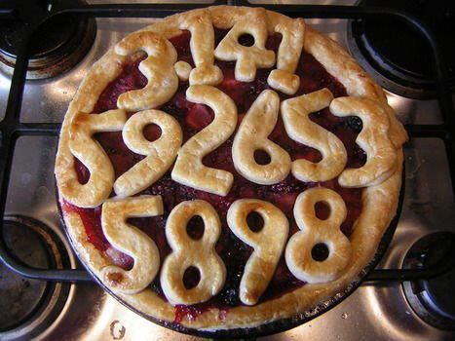

Slide 17
Spin the Flashlight

Slide 18
Point of flashlight
illumination
1
θ
x
x axis

Slide 19
Point of flashlight
illumination
1
θ
x
x axis
1. R.V.': X, Θ

Slide 20
Point of flashlight
illumination
1
θ
x
x axis
1. R.V.': X, Θ
2. Sample space for Θ: [-π/2, π/2]

Slide 21
Point of flashlight
illumination
1
θ
x
x axis
1. R.V.': X, Θ
2. Sample space for Θ: [-π/2, π/2]
3. Θ uniform over [-π/2, π/2]

Slide 22
Point of flashlight
illumination
1
θ
0
x
x axis
1. R.V.': X, Θ
2. Sample space for Θ: [-π/2, π/2]
3. Θ uniform over [-π/2, π/2]
4. (a) F_{X}(x) = P{X<x} = P{tanΘ<x}=P{Θ < tan⁻¹(x)}= 1/2 + (1/π) tan⁻¹(x)
(b) f_{X}(x) =(d/dx) F_{X}(x) = 1/(π)(1 + x²) all x
Cauchy pdf Do you see anything unusual about the Cauchy pdf?

Slide 23
Barriers to Travel
Perturbation Random Variables

Slide 24
Y₀
Directions of travel
0
X₀
E[D] = (1/3) [X₀ + Y₀ ]

Slide 25
Add a barrier to travel
Y₀
a
Directions of travel
0
b
X₀
E[D] = (1/3) [X₀ + Y₀ ]
D' = D + D_{e} , E[D' ]= E[D ] + E[D_{e} ]
E[D_{e} ] = E[D_{e} |D_{e} >0 ] P{D_{e} >0 }

Slide 26
Add a barrier to travel
Y₀
a
Directions of travel
E[D] = (1/3) [X₀ + Y₀ ]
D' = D + D_{e} ,
E[D' ]= E[D ] + E[D_{e} ]
E[D_{e} ] = E[D_{e} |D_{e} >0 ] P{D_{e} >0 }
0
b
X₀
P{D_{e} >0 } = 2 (ab)(a[X₀ - b])/{(X₀Y₀)(X₀Y₀)}

Slide 27
Add a barrier to travel
Y₀
a
Directions of travel
Z₂
Z₁
E[D] = (1/3) [X₀ + Y₀ ]
D' = D + D_{e} ,
E[D' ]= E[D ] + E[D_{e} ]
E[D_{e} ] = E[D_{e} |D_{e} >0 ] P{D_{e} >0 }
0
b
X₀
{D_{e} |D_{e} >0} = 2 MIN [Z₁,Z₂]
E[D_{e} |D_{e} >0] = (2/3)a
P{D_{e} >0 } = 2 (ab)(a[X₀ - b])/(X₀Y₀)(X₀Y₀)

Slide 28
Add 2 barriers to travel
Y₀
a
Directions of travel
Z₂
Z₁
0
b
X₀

Slide 29
And what about grids and one way streets?

Slide 30

Two-Way Streets
m = 7
n = 10
Then, what about alternating one-way streets?

Slide 31
A Quantization Problem

Slide 32
NYC Marine Transfer Station
Tug
Delivers
LIGHTS
Tug
Picks Up
HEAVIES
LIGHT and HEAVY
Barges Stored
Loading
Barge
Barges
Shifted
By Hand
Or Tug
Refuse
Inflow
λ_{i} (t)
Loading
Barge

Slide 33

Data Only Given in Integer Full Barges
Fresh Kills Landfill
TUG
DELIVERS
HEAVIES
Digger
HEAVY BARGES
UNLOADING
BARGE
REFUSE
UNLOADED
HEAVY BARGES
TUGS PICK
UP LIGHTS
UNLOADING
BARGE
LIGHT
BARGES
Digger

Slide 34
1. The R.V.’s
D = barge loads of garbage produced on a random day (continuous r.v.)
Θ = fraction of barge that is filled at beginning of day (0 < Θ < 1)
K = total number of completely filled barges produced by a facility on a random day (K integer)
K = [ D + Θ ] = integer part of D + Θ

Slide 35
2. The Sample Space
θ
1
0
d

Slide 36
θ
1
0
1
2
3
d

Slide 37
θ
1
K = 0
K = 1
K = 2
K = 3
0
1
2
3
d

Slide 38
3. Joint Probability Distribution
a) D and Θ are independent.
b) Θ is uniformly distributed over [0, 1]
f_{D,Θ}(d, θ) = f_{D}(d) f_{Θ}(θ) = f_{D}(d)(1) = f_{D}(d), d > 0, 0 <θ <1
θ
1
K = 0
K = 1
K = 2
K = 3
0
1
2
3
d

Slide 39
3. Joint Probability Distribution
a) D and Θ are independent.
b) Θ is uniformly distributed over [0, 1]
f_{D,Θ}(d, θ) = f_{D}(d) f_{Θ}(θ) = f_{D}(d)(1) = f_{D}(d), d > 0, 0 <θ <1
θ
1
x
K = 0
K = 1
K = 2
K = 3
1-x
0
1
x
1-x
2
3
d

Slide 40
4. Working in the Joint Sample Space
Look at E [K |D = d ]
Let d = i + x 0 < x <1
E [K |D = i + x ] = i (1 - x) + (i + 1) x = i + x = d
Implies E [ K ] = E [ D ] (unbiased)
θ
1
x
K = 0
K = 1
K = 2
K = 3
1-x
0
1
x
1-x
2
3
d

Slide 41
Bertrand's Parodox

Slide 42
random chord
radius = 1

Slide 43
random chord
radius = 1
Bertrand's Parodox: What is the probability that a random chord
on this circle has length greater than ?

Slide 44
random chord
radius = 1
Bertrand's Parodox: What is the probability that a random chord
on this circle has length greater than ?
Three correct answers: 1/3, 1/4 and 1/2 !!!!
Be very careful about that ambiguous word, "random".
See text for a sample space, probability assignment argument.

Slide 45
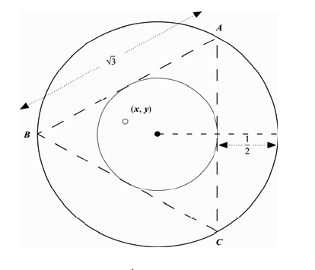
Bertrand 1: The chord’s 2 end points are random on the circumference of the circle.
x₁
x₂
Prob.=
1/3
x₂

Slide 46
Bertrand 2: The Mid-Point of the Chord is Random Inside Circle
Prob. =
1/4

Slide 47

Bertrand 3: The Radial Distance of the Chord Mid-Point is Random in [0, 1]
Prob.
= 1/2

